Slide 1
Carparking Application

Slide 2
Team - B
TEAM MEMBERS
Aditya Purohit
Ayush Atte
Aman Singh Patel
Annanya Rajpal

Slide 3
Problem Statement
Carparking Application is to provide show all the nearby parking spots according to nearest location and help the users to find a parking spot.

Slide 4
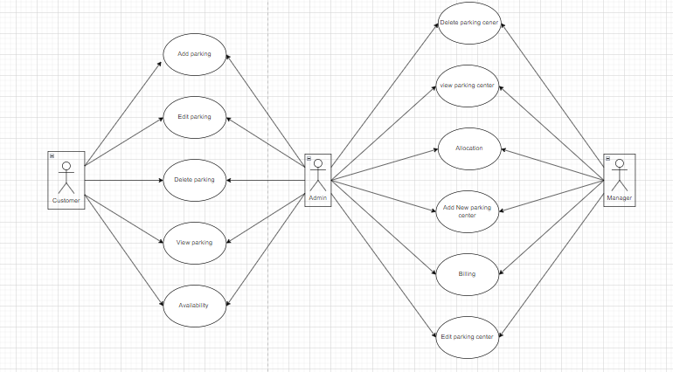
Use Case Diagram

Slide 5
Technology Used
JAVA 11
MYSQL
Swagger
Eclipse
Spring Boot

Slide 6
Features
Admin can Add/Edit/Delete/View parking details.
Manager can seach for new parking for lease, parking allocation, Parking availability service
Customer can search service, have a preference to search for near by parking and Parking booking service/billing

Slide 7
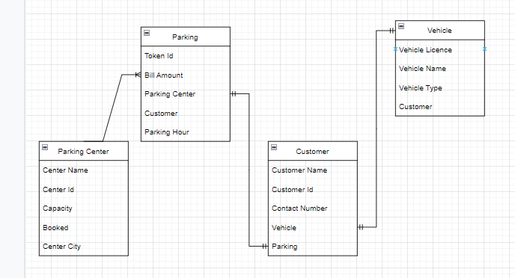
Entity Relationship Diagram

Slide 8
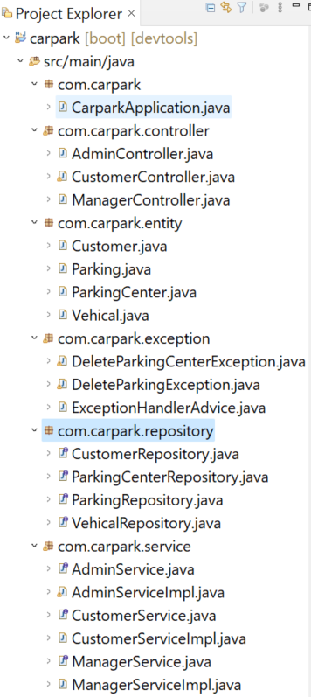
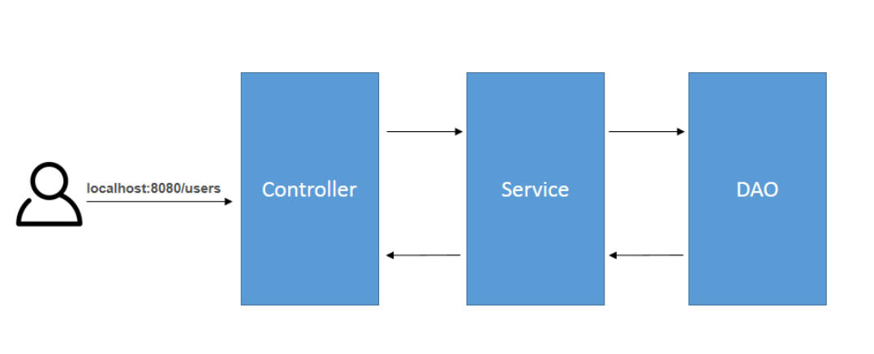
Project Structure

Slide 9
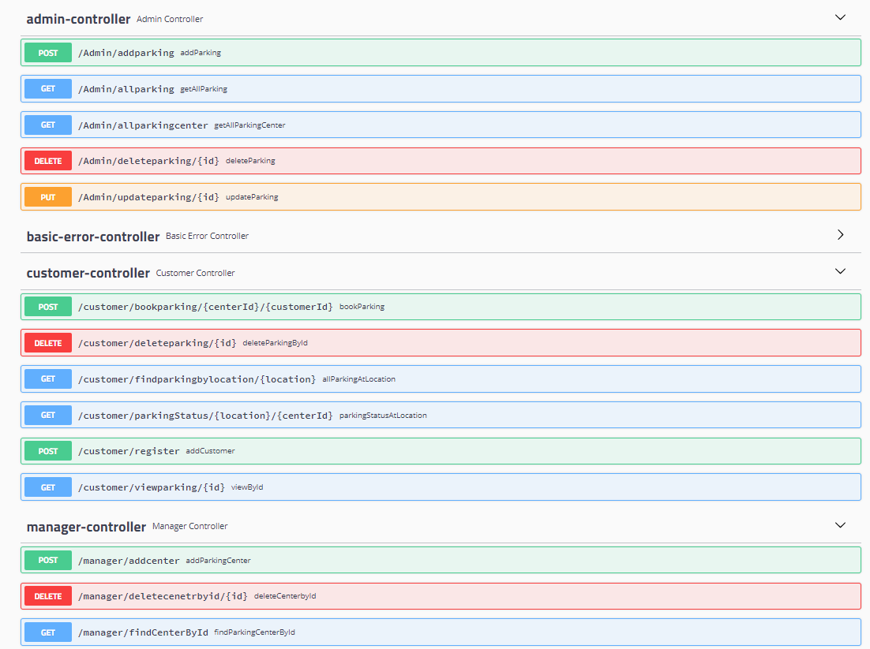
Rest API end points

Slide 10

Questions ?

Slide 11
Thank you

